Slide 1

Difference between :
Data base
Data mining
Data warehouse

Slide 2
Definition: A structured collection of data stored and accessed electronically. Databases are typically designed to manage, retrieve, and store data efficiently.
Characteristics:
Structure: Organized using tables, rows, and columns.
Management Systems: Managed by Database Management Systems (DBMS) such as MySQL, PostgreSQL, Oracle, and SQL Server.
Transactions: Supports CRUD (Create, Read, Update,
Delete) operations to handle data.
Usage: Suitable for managing day-to-day operational data in applications, from small personal data management to large enterprise applications.
Examples: Customer information databases, product inventory databases, and employee records.
Data base :

Slide 3
Definition: The process of analyzing large datasets to discover patterns, trends, and useful insights.
Characteristics:
Techniques: Uses algorithms and statistical models, such as
clustering, classification, regression, and association.
Goal: To identify hidden patterns, relationships, and trends that may not be immediately apparent.
Tools: Common tools include Python libraries, R, RapidMiner, and
specialized platforms like SAS and IBM SPSS.
Usage: Used in various fields like marketing for customer segmentation, finance for fraud detection, and healthcare for predictive diagnostics.
Examples: Recommending products to customers based on past purchases, predicting customer churn, and finding associations in transaction data.
Data Mining:

Slide 4
Definition: A large, centralized repository designed to store and manage historical data from multiple sources, typically for business intelligence and analytical purposes.
Characteristics:
Data Integration: Collects data from various operational databases and external sources.
Structure: Organized for optimized query performance, often using star or snowflake schemas.
ETL Process: Uses ETL (Extract, Transform, Load) processes to ensure data consistency and readiness for analysis.
Tools: Examples include Amazon Redshift, Snowflake, Google BigQuery, and Microsoft Azure Synapse.
Usage: Primarily used for data analysis, reporting, and decision-making. Data warehouses support complex queries and generate insights for long-term strategic decisions.
Examples: Sales and customer behavior analysis over time, trend analysis, and financial reporting.
Data Warehouse:

Slide 5
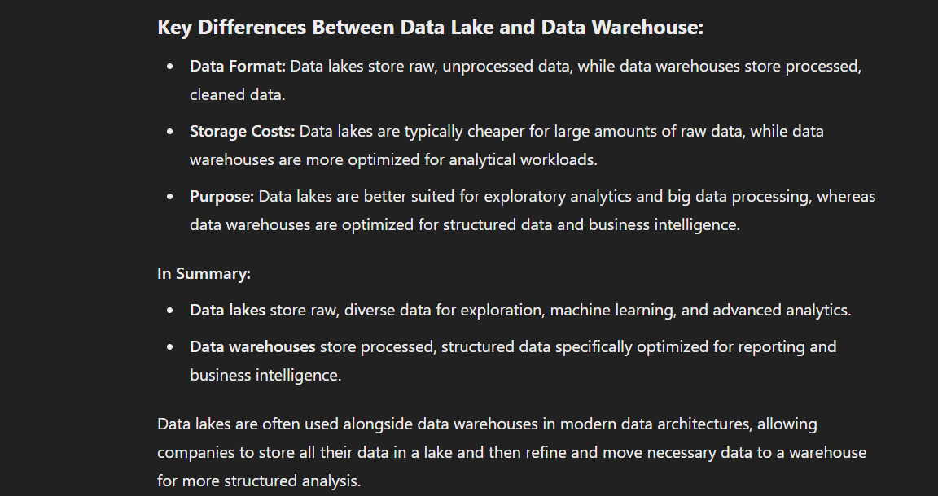

Slide 6
In Summary: Databases handle day-to-day operations and real-time data. Data Mining discovers hidden insights and patterns within large datasets. Data Warehouses store and manage historical data for long-term analytical and business intelligence use. Data lakes store raw, diverse data for exploration, machine learning, and advanced analytics.

